Slide 1
Outline of talk
In this introduction the main questions to be addressed will be:
–What is software project management? Is it really different from ‘ordinary’ project management?
–How do you know when a project has been successful? For example, do the expectations of the customer/client match those of the developers?

Slide 2
What is a project?
Some dictionary definitions:
“A specific plan or design”
“A planned undertaking”
“A large undertaking e.g. a public works scheme”
Longmans dictionary
Key points above are planning and size of task

Slide 3
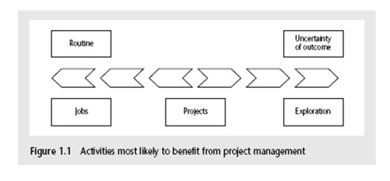
Jobs versus projects
‘Jobs’ – repetition of very well-defined and well understood tasks with very little uncertainty
‘Exploration’ – e.g. finding a cure for cancer: the outcome is very uncertain
‘Projects’ – in the middle!

Slide 4
Characteristics of projects
A task is more ‘project-like’ if it is:
Non-routine
Planned
Aiming at a specific target
Work carried out for a customer
Involving several specialisms
Made up of several different phases
Constrained by time and resources
Large and/or complex

Slide 5
Are software projects really different from other projects?
Not really! …but…
Invisibility
Complexity
Conformity
Flexibility
make software more problematic to build than other engineered artefacts.

Slide 6
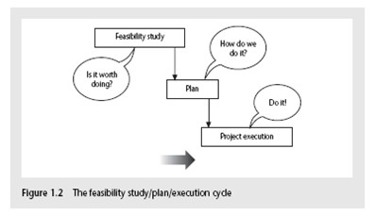
Activities covered by project management
Feasibility study
Is project technically feasible and worthwhile from a business point of view?
Planning
Only done if project is feasible
Execution
Implement plan, but plan may be changed as we go along

Slide 7
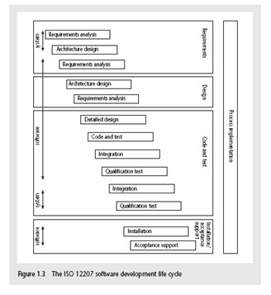
The software development life- cycle (ISO 12207)

Slide 8
ISO 12207 life-cycle
Requirements analysis
–Requirements elicitation: what does the client need?
–Analysis: converting ‘customer-facing’ requirements into equivalents that developers can understand
–Requirements will cover
Functions
Quality Resource
constraints i.e. costs

Slide 9
ISO 12207 life-cycle
Architecture design
Based on system requirements
Defines components of system: hardware, software, organizational
Software requirements will come out of this
Code and test
Of individual components
Integration
Putting the components together

Slide 10
ISO12207 continued
Qualification testing
Testing the system (not just the software)
Installation
The process of making the system operational
Includes setting up standing data, setting system parameters, installing on operational hardware platforms, user training etc
Acceptance support
Including maintenance and enhancement

Slide 11
Some ways of categorizing projects
Distinguishing different types of project is important as different types of task need different project approaches e.g.
Information systems versus embedded systems
Objective-based versus product-based

Slide 12
What is management?
This involves the following activities:
Planning – deciding what is to be done
Organizing – making arrangements
Staffing – selecting the right people for the job
Directing – giving instructions
continued…

Slide 13
What is management? (continued)
Monitoring – checking on progress
Controlling – taking action to remedy hold- ups
Innovating – coming up with solutions when problems emerge
Representing – liaising with clients, users, developers and other stakeholders

Slide 14
Setting objectives
Answering the question ‘What do we have to do to have a success?’
Need for a project authority
Sets the project scope
Allocates/approves costs
Could be one person - or a group
Project Board
Project Management Board
Steering committee

Slide 15
Objectives
Informally, the objective of a project can be defined by completing the statement:
The project will be regarded as a success if………………………………..
Rather like post-conditions for the project
Focus on what will be put in place, rather than how activities will be carried out

Slide 16
Objectives should be SMART
S – specific, that is, concrete and well-defined
M – measurable, that is, satisfaction of the objective can be objectively judged
A – achievable, that is, it is within the power of the individual or group concerned to meet the target
R – relevant, the objective must relevant to the true purpose of the project
T – time constrained: there is defined point in time by which the objective should be achieved

Slide 17
Goals/sub-objectives
These are steps along the way to achieving the objective. Informally, these can be defined by completing the sentence…
Objective X will be achieved IF the following goals are all achieved A……………
B……………
C…………… etc

Slide 18
Goals/sub-objectives continued
Often a goal can be allocated to an individual. Individual may have the capability of achieving goal, but not the objective on their own e.g.
Objective – user satisfaction with software product
Analyst goal – accurate requirements
Developer goal – software that is reliable

Slide 19
Measures of effectiveness
How do we know that the goal or objective has been achieved?
By a practical test, that can be objectively assessed.
e.g. for user satisfaction with software product:
Repeat business – they buy further products from us
Number of complaints – if low etc etc

Slide 20
Stakeholders
These are people who have a stake or interest in the project
In general, they could be users/clients or developers/implementers
They could be:
Within the project team
Outside the project team, but within the same organization
Outside both the project team and the organization

Slide 21
The business case
Benefits of delivered project must outweigh costs
Costs include:
Development
Operation
Benefits
Quantifiable
Non-quantifiable

Slide 22
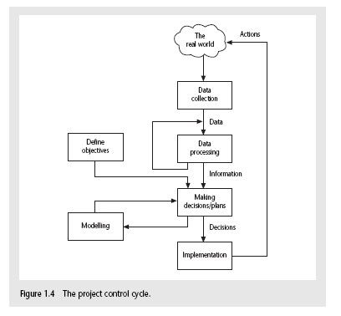
Management Control

Slide 23
Management Control
Data – the raw details
e.g. ‘6,000 documents processed at location X’
Information – the data is processed to produce something that is meaningful and useful
e.g. ‘productivity is 100 documents a day’
Comparison with objectives/goals
e.g. we will not meet target of processing all documents by 31 st March

Slide 24
Management Control (Continued)
Modelling – working out the probable outcomes of various decisions
e.g. if we employ two more staff at location X how quickly can we get the documents processed?
Implementation – carrying out the remedial actions that have been decided upon

Slide 25
Key points in lecture
Projects are non-routine - thus uncertain
The particular problems of projects e.g. lack of visibility
Clear objectives are essential which can be objectively assessed
Stuff happens. Not usually possible to keep precisely plan – need for control
Communicate, communicate, communicate!

